Slide 1

DATA &
INFORMATION SECURITY
2020

Slide 2

Administrative Details
Grade | 80% test, 20% homework
4 homework assignments
Office hours after lesson - via Zoom
E-mail: niv.gilboa@gmail.com
Tel. 054-6501047

Slide 3


Link to lessons – Moodle
Student questions > via Zoom chat
Answer my questions > by Zoom “raise hand” feature
Cameras on during lesson

Slide 4
Course Outline
MODERN ALGEBRA
NUMBER THEORY
ENCRYPTION
DATA INTEGRITY
AUTHENTICATION (IDENTIFICATION)
CRYPTOGRAPHIC PROTOCOLS
REAL WORLD SECURITY SYSTEMS
INTRODUCTION TO SOFTWARE SECURITY
2020

Slide 5
Bibliography
Introduction to Modern Cryptography / Katz, Lindell
Handbook of Applied Cryptography / Menezes, Van Oorschot, Vanstone
Introduction to Algorithms / Cormen, Leiserson, Rivest
Cryptography Theory and Practice / D. Stinson

Slide 6
Groups

Slide 7
Definition
A set G and a binary operation ⊕ with the following properties:
Closure - ∀a,b∈G, a⊕b∈G
Associativity - ∀a,b,c∈G, (a⊕b)⊕c=a⊕(b⊕c)
Unit element - ∃e∈G, ∀a∈G, a⊕e=e⊕a=a
Reciprocity - ∀a∈G, ∃a⁻¹∈G, a⊕a⁻¹ = e
Commutative (or abelian) groups
∀a,b∈G, a⊕b=b⊕a

Slide 8
Examples I
Is (ℕ,+) a group?
No reciprocal
Is (ℤ,+) a group?
Closed – yes
Associative – yes
Unit element – 0
Reciprocal of a: -a

Slide 9
Examples II
We’re interested only in finite groups
The additive group modulo n, (ℤ_{n} ,+_{n})
- ℤ_{n} ={0,1,…,n-1}, a+nb= (a+b) mod n
- Closed
- Associative – easy
- Unit element – 0
- Reciprocal – 0 reciprocal of 0, n-a reciprocal of a≠0

Slide 10
Examples III
Example: the group V_{n}: ({0,1}^{n},⊕)
- Closed – yes
- Associative – associative on each bit
- Unit element – 00…0
- Reciprocal of a - a

Slide 11
Multiplicative Group Attempts
{0,…,n-1} with the operation ⋅_{n}
- Unit element 1
- No reciprocal for 0
{1,…,n-1} with the operation ⋅_{n}
This last is a group for n=5, but not for n=6
- What about closure?
- What elements have reciprocals?
- How are the reciprocals computed?

Slide 12
Factors
d|a denotes that d divides a.
Prime numbers are divided by 1 and themselves
Claim: there is an infinite number of primes
Proof:
Assume k primes, 2≤p₁<p₂<….<p_{k}
Let P=1+Π_{i} p_{i}
p_{i} does not divide P
There is a prime q∉{p₁,…,p_{k}}

Slide 13
Greatest Common Divisor
GCD of a and b is denoted by (a,b)
Examples
- (35,15)=5
- (15,8)=1
- (7,5)=1
Claim: let a and b be integers. There are unique integers q and r, 0≤r<b, such that a=qb+r.

Slide 14
Euclid’s Algorithm I
Theorem: for any nonnegative integer a and positive integer b- (a,b)=(b, a mod b).
Proof:
∃q,r∈ℤ, 0≤r<b, a=qb+r
r=a mod b
(a,b) | a, (a,b) | b ➔
a-qb=(a,b)(a/(a,b)-qb/(a,b))
➔(a,b) | b, (a,b) | r
➔ (a,b) ≤ (b,r)=(b,a mod b) (1)

Slide 15
Euclid’s Algorithm II
Proof (cont.)
- (b,r) | b, (b,r) | r ➔ (b,r) | qb+r ➔ (b,r)|a
- ➔(b,r)≤(a,b) (2)
- (1) & (2) ➔ (a,b)=(b, a mod b)

Slide 16
Euclid’s Algorithm III
Euclid(a,b)
- If b==0 return a;
- Return Euclid (b, a mod b)
a | b | (a,b)
35 | 25 | 5
25 | 10 | 5
10 | 5 | 5
5 | 0 | 5

Slide 17
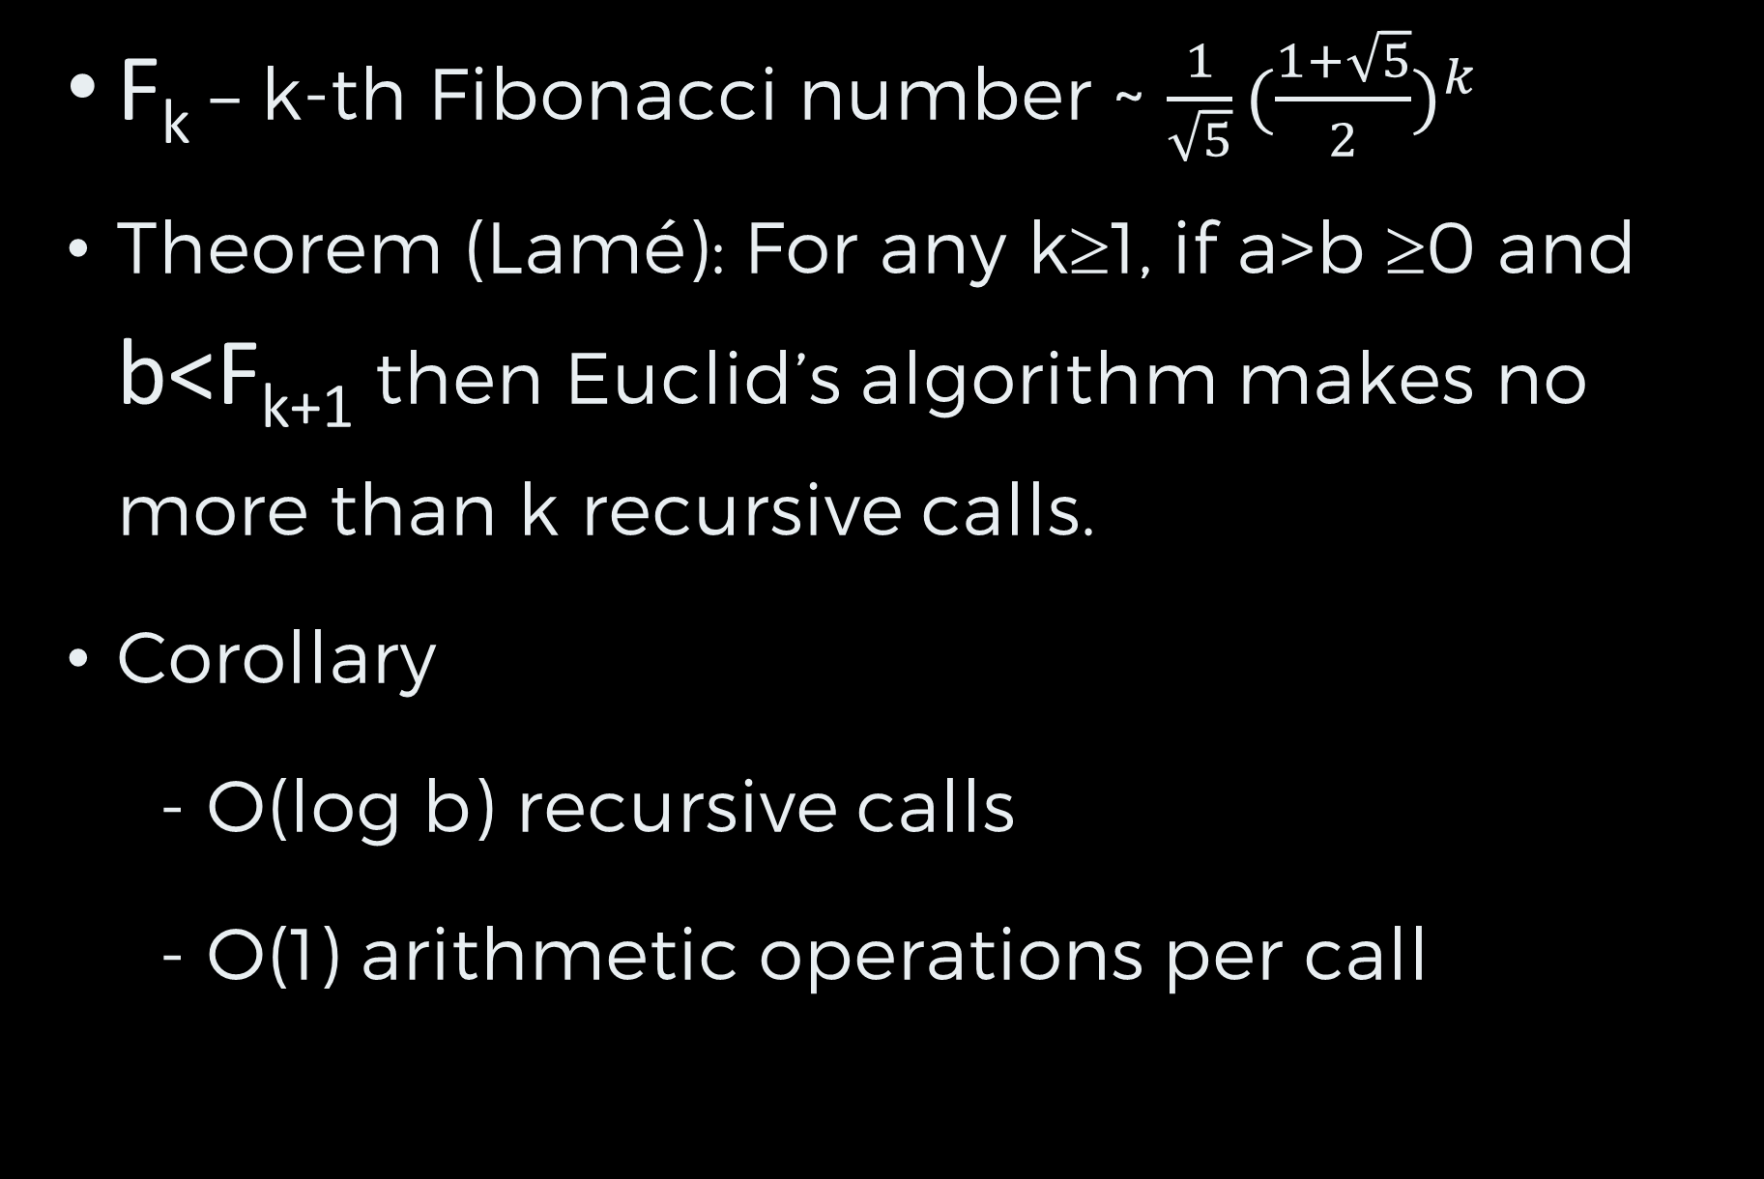
Euclid’s Algorithm IV
F_{k} – k-th Fibonacci number ~ ${\frac{1}{\sqrt{5}}(\frac{1+\sqrt{5}}{2})}^{k}$
Theorem (Lamé): For any k≥1, if a>b ≥0 and b<F_{k+1} then Euclid’s algorithm makes no more than k recursive calls.
Corollary
- O(log b) recursive calls
- O(1) arithmetic operations per call

Slide 18
Extended Euclid I
Theorem: Let a and b be integers, not both zero, then there exist integers x, y such that ax+by=(a,b)
Examples
a=35, b=25
x=-2, y=3 ➔ ax+by=5
x=3, b=-4 ➔ ax+by=5
a=7, b=11
x=-3, b=2 ➔ ax+by=1

Slide 19
Extended Euclid II
Extended Euclid (a,b)
If b==0 return (a,1,0)
(d’,x’,y’)=(Extended Euclid(b, a mod b))
(d,x,y)=(d’,y’,x’- y’⎣a/b⎦)
Return (d,x,y)
a | b | (a,b) | x | y
49 | 35 | 7 | -2 | 3
35 | 14 | 7 | 1 | -2
14 | 7 | 7 | 0 | 1
7 | 0 | 7 | 1 | 0

Slide 20
Extended Euclid III
(d,x,y)=(d’,y’,x’- y’⎣a/b⎦)
a | b | (a,b) | x | y
49 | 35
35 | 14
14 | 7
7 | 0 | 7 | 1 | 0

Slide 21
Extended Euclid III
(d,x,y)=(d’,y’,x’- y’⎣a/b⎦)
a | b | (a,b) | x | y
49 | 35 | 7 | -2 | 3
35 | 14 | 7 | 1 | -2
14 | 7 | 7 | 0 | 1
7 | 0 | 7 | 1 | 0
ax+by=14⋅0+7⋅1=7=(a,b)
ax+by=35⋅1+14⋅(-2)=7=(a,b)
ax+by=49⋅(-2)+35⋅3=7=(a,b)

Slide 22
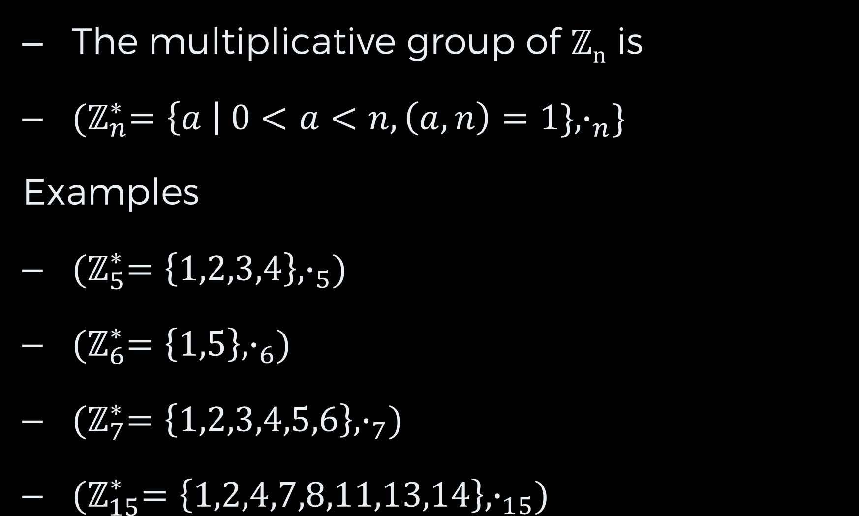
Multiplicative Group I
The multiplicative group of ℤ_{n} is
${(ℤ}_{n}^{∗}=\left\{a \right| 0<a<n, \left(a,n\right)=1\}, ∙_{n}\}$
Examples
${(ℤ}_{5}^{∗}=\left\{1,2,3,4\right\},∙_{5})$
${(ℤ}_{6}^{∗}=\left\{1,5\right\},∙_{6})$
${(ℤ}_{7}^{∗}=\left\{1,2,3,4,5,6\right\},∙_{7})$
${(ℤ}_{15}^{∗}=\left\{1,2,4,7,8,11,13,14\right\},∙_{15})$

Slide 23
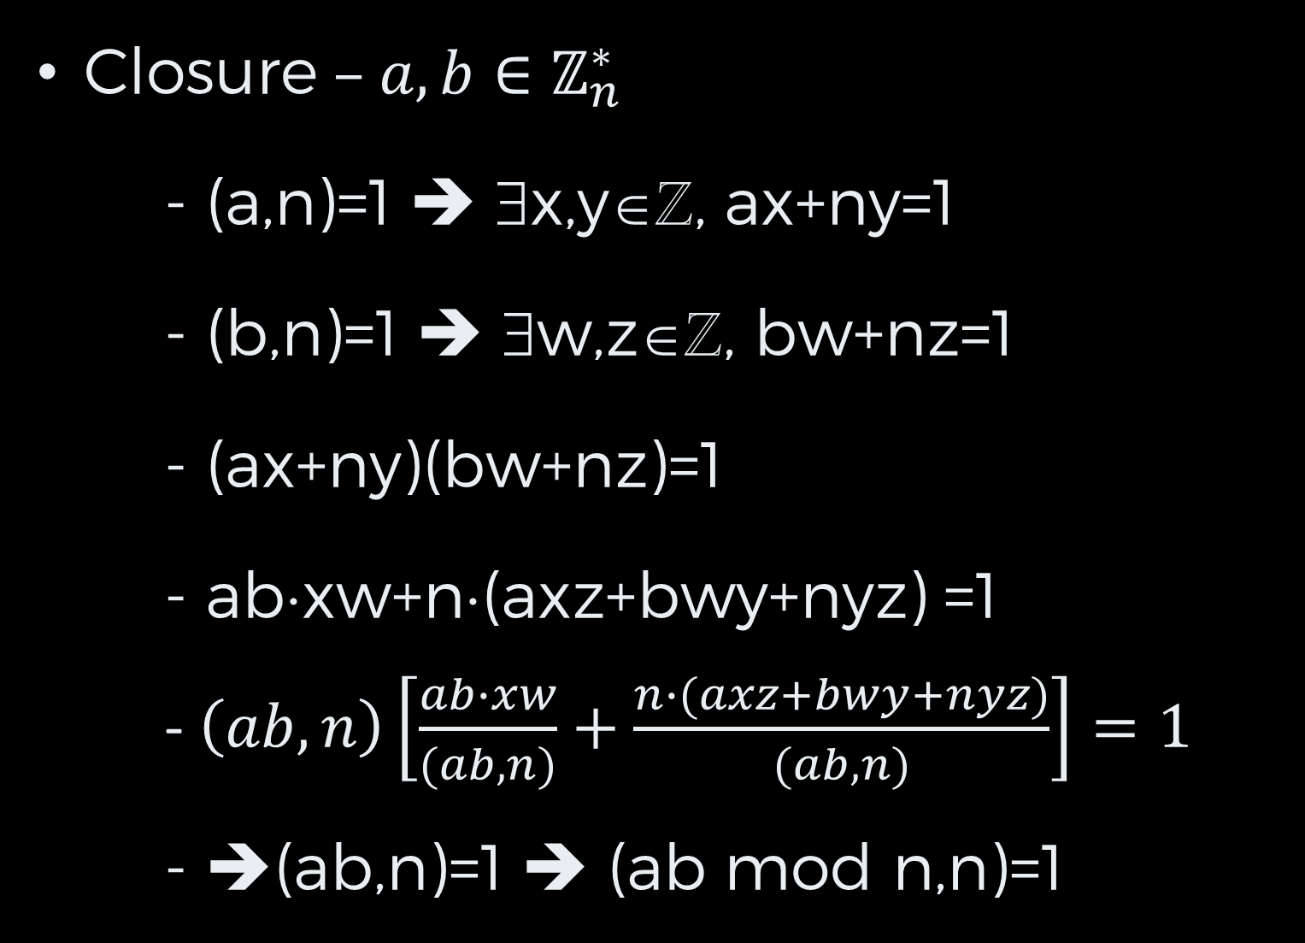
Multiplicative Group II
Closure – $a,b∈ℤ_{n}^{∗}$
- (a,n)=1 ➔ ∃x,y∈ℤ, ax+ny=1
- (b,n)=1 ➔ ∃w,z∈ℤ, bw+nz=1
- (ax+ny)(bw+nz)=1
- ab⋅xw+n⋅(axz+bwy+nyz) =1
- $\left(ab,n\right)\left[\frac{ab∙xw}{(ab,n)}+\frac{n∙(axz+bwy+nyz)}{(ab,n)}\right]=1$
- ➔(ab,n)=1 ➔ (ab mod n,n)=1
Integer!

Slide 24
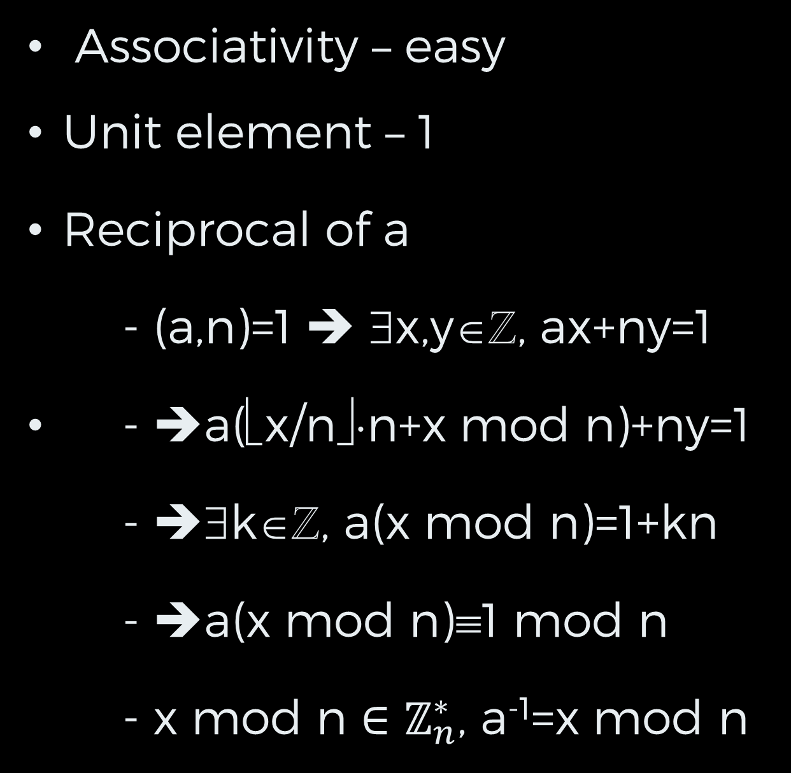
Multiplicative Group III
Associativity – easy
Unit element – 1
Reciprocal of a
- (a,n)=1 ➔ ∃x,y∈ℤ, ax+ny=1
- ➔a(⎣x/n⎦⋅n+x mod n)+ny=1
- ➔∃k∈ℤ, a(x mod n)=1+kn
- ➔a(x mod n)≡1 mod n
- x mod n ${∈ℤ}_{n}^{∗}$, a⁻¹=x mod n

Slide 25
Multiplicative Group IV
The number of elements is Euler’s Totient function φ(n)
If n is prime
φ(n)=n-1
If n=PQ, and P, Q are prime then
φ(n) =PQ-P-Q+1
=(P-1)(Q-1)

Slide 26
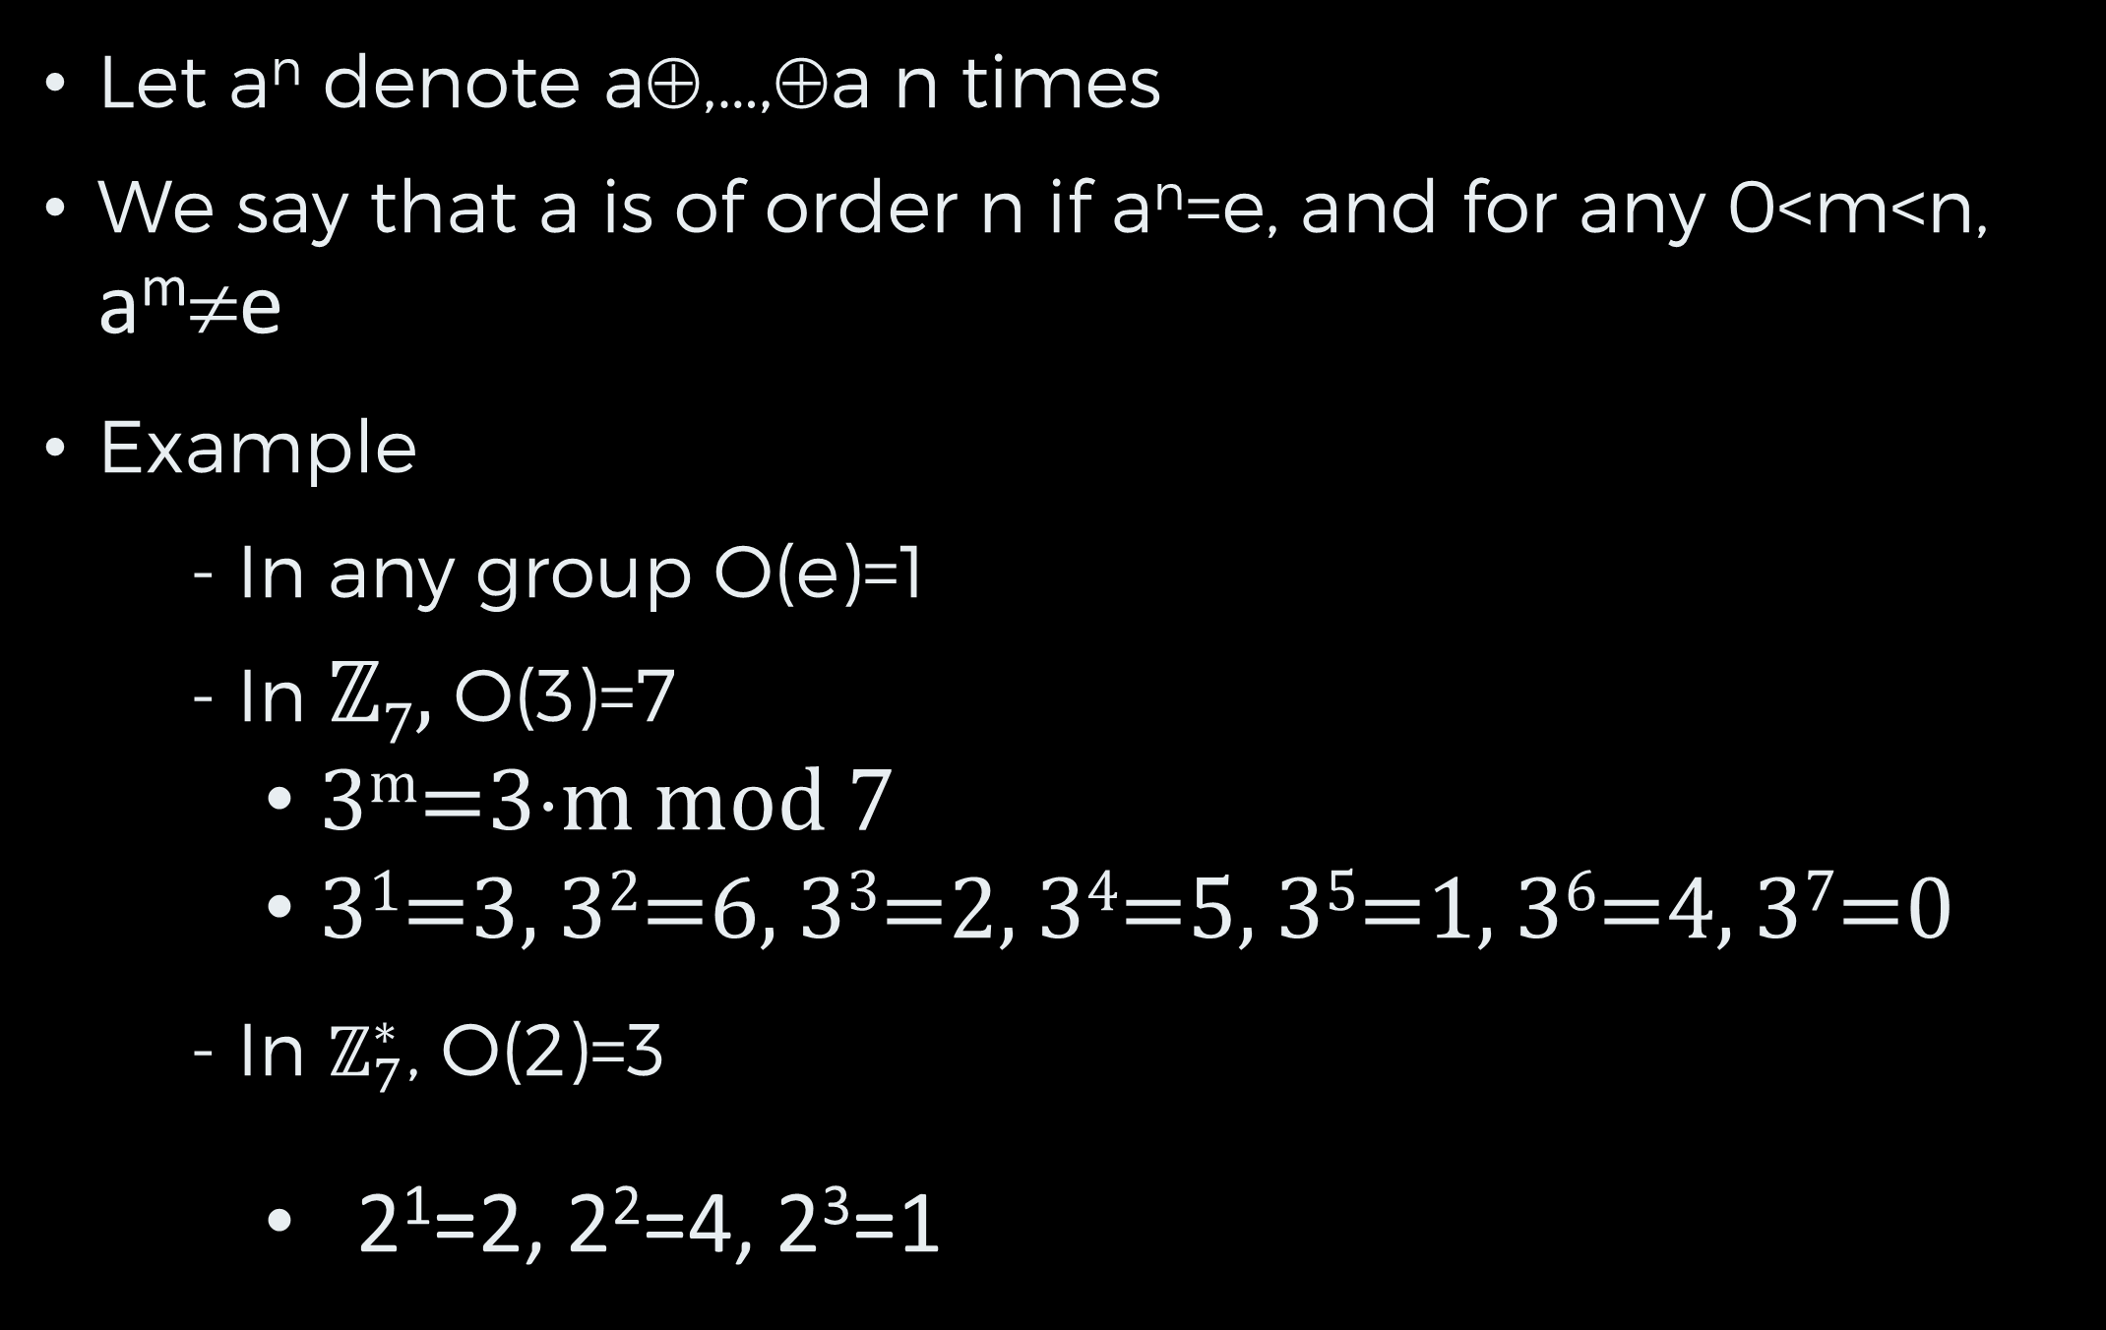
Order of Elements I
Let a^{n} denote a⊕,…,⊕a n times
We say that a is of order n if a^{n}=e, and for any 0<m<n, a^{m}≠e
Example
- In any group O(e)=1
- In ℤ₇, O(3)=7
3^{m}=3⋅m mod 7
3¹=3, 3²=6, 3³=2, 3⁴=5, 3⁵=1, 3⁶=4, 3⁷=0
- In $ℤ_{7}^{∗}$, O(2)=3
2¹=2, 2²=4, 2³=1

Slide 27
Order of Elements II
Theorem: Let (G, ⊕) be a finite group and g be an element of the group. Then the order of g ≤ |G| (in fact , g^{|G|}=e, see Lagrange theorem).
Corollary: in the multiplicative group of Z_{n} any element is of order at most φ(n)

Slide 28
Proof
Consider g⁰,g¹,g²,…g^{|G|}
Closure + Pigeonhole principle
- ➔ ∃0≤j<k≤|G|, g^{j}=g^{k}
Multiply by g⁻¹➔ g^{j-1}=g^{k-1}
Repeat ➔ e=g⁰=g^{k-j}
0<k-j≤|G|
➔0<O(g)≤k-j

Slide 29
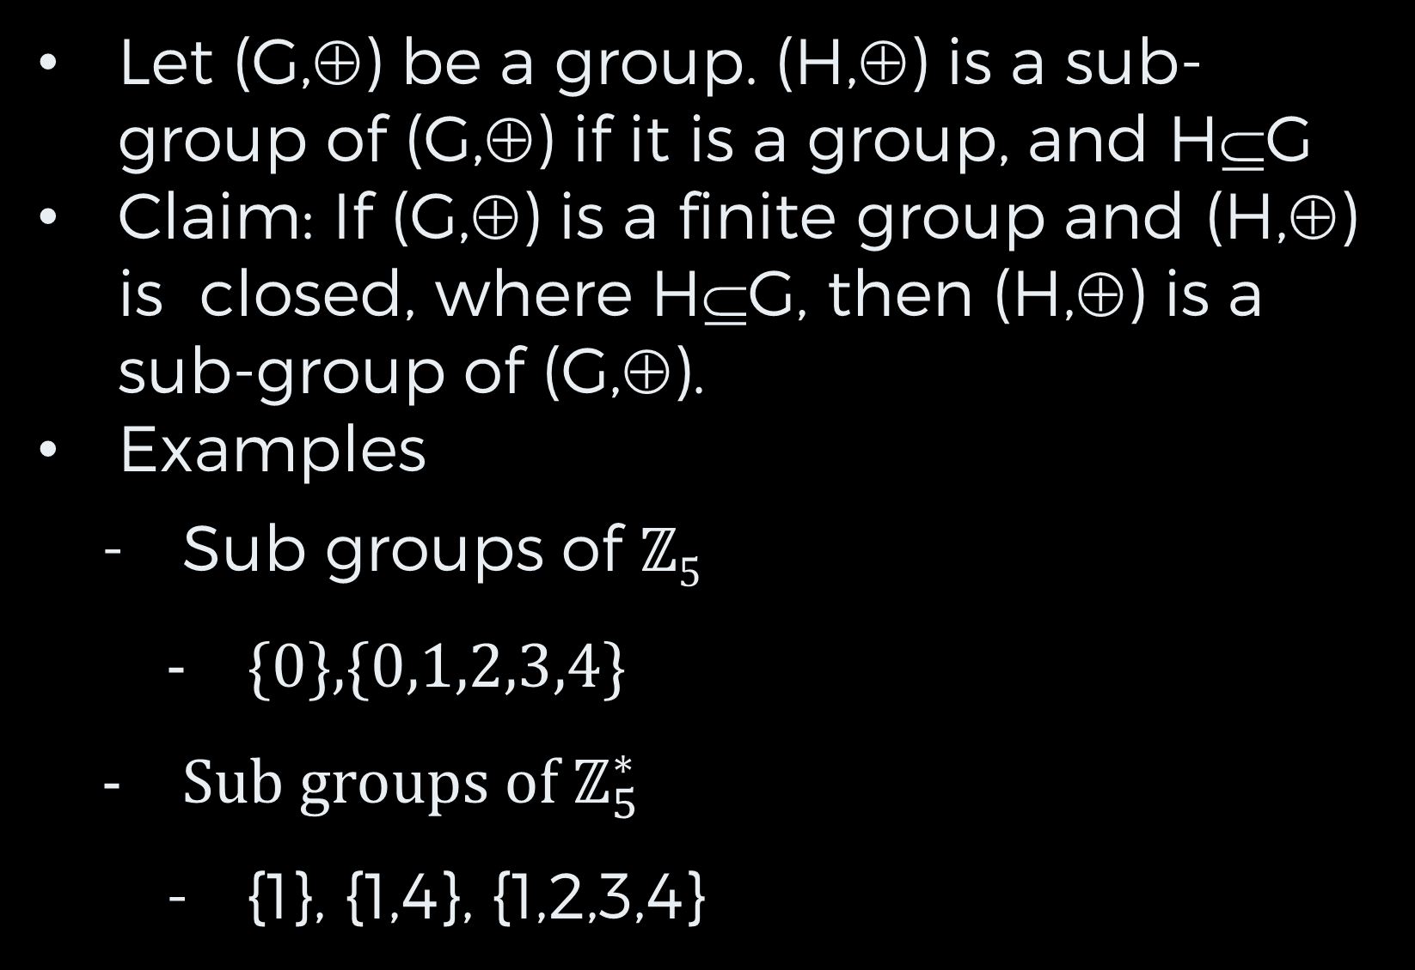
Sub-Groups I
Let (G,⊕) be a group. (H,⊕) is a sub-group of (G,⊕) if it is a group, and H⊆G
Claim: If (G,⊕) is a finite group and (H,⊕) is closed, where H⊆G, then (H,⊕) is a sub-group of (G,⊕).
Examples
Sub groups of ℤ₅
{0},{0,1,2,3,4}
Sub groups of $ℤ_{5}^{∗}$
{1}, {1,4}, {1,2,3,4}

Slide 30
Sub-Groups II
Lagrange theorem: if G is finite and (H,⊕) is a sub-group of (G,⊕) then |H| divides |G|
Examples

Slide 31
To Be
CONTINUED…

